Slide 1
Regional Transportation Plan (RTP) workshop & State Transportation Improvement Program (STIP)
Community outreach / input on
Regional Transportation Plan or RTP which provides a vision of Mono County’s regional transportation goals, policies, objectives and strategies for staff and decision makers (Board of Supervisors, Planning Commission, and or Local Transportation Commission). This is the policy document for transportation which is also the Circulation Element of the General Plan.
State Transportation Improvement Program or STIP is a funding program to help implement and advance goals, policies, objectives, and or strategies of the RTP / Circulation Element.
Notes:
RTPs are state mandated GC

Slide 2
Regional Transportation Plan (RTP) / Circulation Element
Overview and Purpose of the Regional Transportation Plan
Provide a clear vision of the regional transportation goals, policies, objectives and strategies for the Regional Transportation Planning Agencies (RTPAs)
Provide an assessment of the current modes of transportation and the potential of new travel options within the region.
Identify and document specific actions necessary to address the region’s mobility and accessibility needs.
For Mono Co, serves two purposes as required by state law – Regional Transportation Planning Agency (RTPA or LTC) and the circulation element of the General Plan – one document for both
RTP is linked with TOML & Mono Co Housing Elements
Reasons for this update are minor changes in RTP guidelines, technical changes to funding tables in the RTP, and adoption of the 2024 STIP
Notes:
RTPs are state mandated GC

Slide 3
Regional Transportation Plan (RTP) / Circulation Element
Regional Transportation Plan – Elements
1) Planning Process
2) Existing Transportation Network
3) Needs Assessment
4) Regional Policy Element - focus
5) Community Policy Element - focus
6) Action Element
7) Financial Element

Slide 4
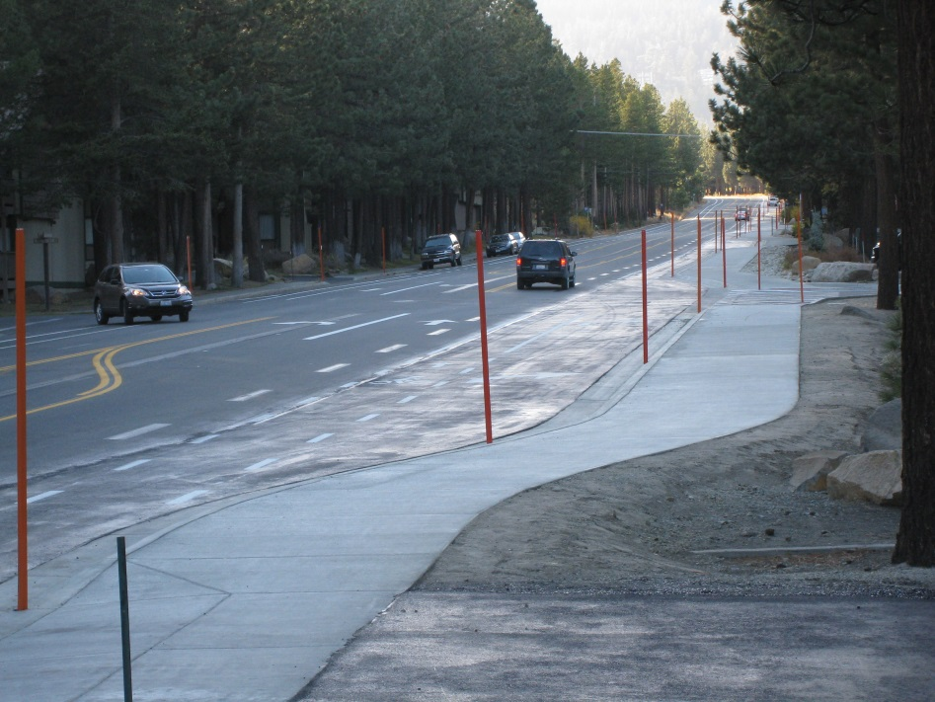
Regional Transportation Plan (RTP) / Circulation Element
Chapter 4) Regional Policy Element – Goals, Policies and Objectives for the following areas:
Land use issues
Economic factors
Resource Efficiency
Environmental issues
Livable communities
Operational Improvements
Non-motorized transportation (ATP)
Transit
Parking
Aviation
Plan Consistency
Public Participation
Performance Measures (STIP, Rural Performance Measures, Qualitative vs. Quantitative, Asset Management/SWITRS)

Slide 5
Regional Transportation Plan (RTP) / Circulation Element
Community Policies - Antelope Valley
Goal:
To provide and maintain an orderly, safe, and efficient transportation system that preserves the rural character of the Antelope Valley.
Objective 18.A. Retain the existing scenic qualities of US 395 in the Antelope Valley.
Policy 18.A.1. Ensure that future highway improvements in the Antelope Valley protect the scenic qualities in the area.
Policy 18.A.2. Consider additional landscaping along US 395 in appropriate areas.
Policy 18.A.3. Support preservation of the existing heritage trees along US 395 in a manner that ensures roadway safety.
Objective18. B. Support safety improvements to the existing circulation system in the Valley.
Policy 18.B.1. Support operational improvements to the existing two-lane US 395.
Action 18.B.1.a. Promote shoulder widening along US 395 to allow for bike, pedestrian, and equestrian use.
Action 18.B.1.b. Promote the installation of turn lanes on US 395 as needed.
Action 18.B.1.c. Consider improvements to reduce deer collisions in the Valley as needed.
Action 18.B.1.d. Study potential operational and safety improvements at the intersection of Eastside Lane and US 395.
Action 18 B.1.e. Promote traffic calming and safety improvements through Main Street/US 395 in the communities of Coleville / Walker.

Slide 6
Regional Transportation Plan (RTP) / Circulation Element
Community Policies - Antelope Valley (continued)
Objective 18.C. Provide a loop trail system in the Valley for use by bicyclists and pedestrians.
Policy 18.C.1. Seek funding for development of multi-use and single-purpose trails along routes to be identified in the Valley.
Objective 18.D. Develop a main street program for US 395 in Walker.
Policy 18.D.1. Create a Main Street plan for Walker to improve the visitor experience, provide for enhanced wayfinding and use of community assets (park, community center, Mountain Gate, etc.) for residents and visitors.
Action 18.D.1.a. Seek grant funding for a Main Street program in cooperation with business owners, Caltrans, and the Regional Planning Advisory Committee.

Slide 7
Regional Transportation Plan (RTP) / Circulation Element
6) Action Element
2024 Regional Transportation Improvement Program
7) Financial Element
2024 RTIP, data updates (tables), other technical changes
Comments/Questions on RTP?

