Slide 1
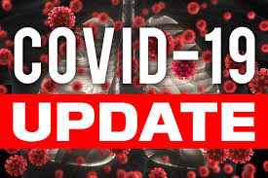



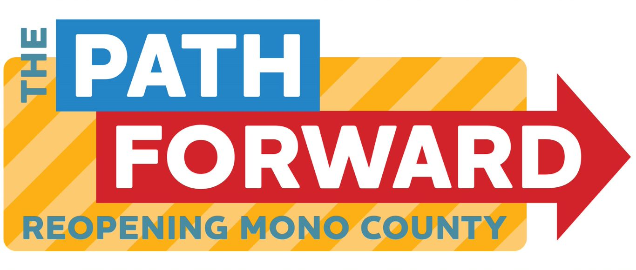
Board of supervisors meeting april 12, 2022

Slide 2
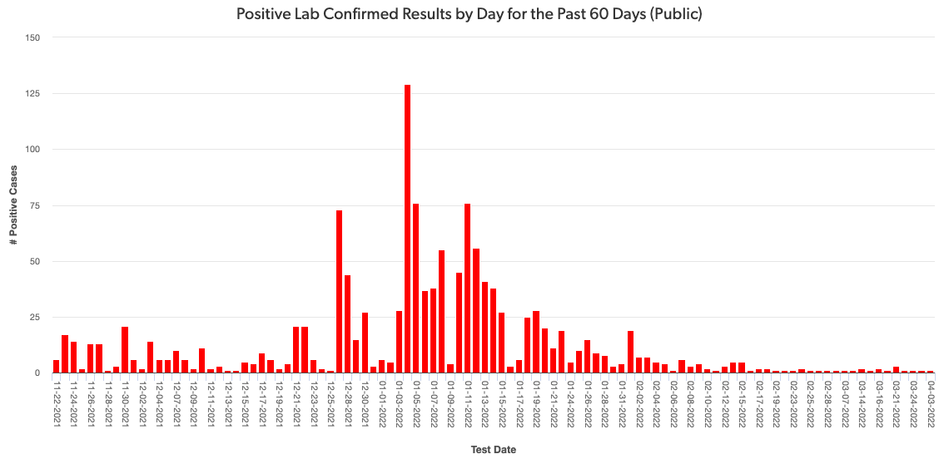
Mono county metrics
Tested – 2,553
Negative – 2,347 pending - 125
Positive – 84 deaths - 1 positivity rate – 3.29%
Total positive cases (PCR Conf): 2970 Positivity rate: 1.7%/ Case Rate/100,000: 8.2

Slide 3
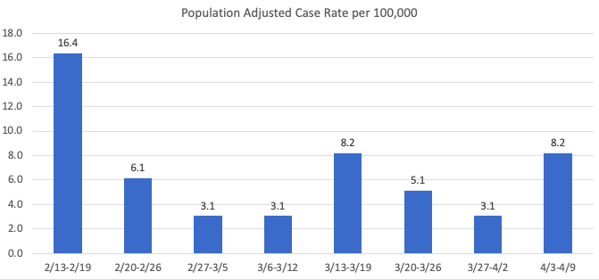
Recent mETrics

Slide 4
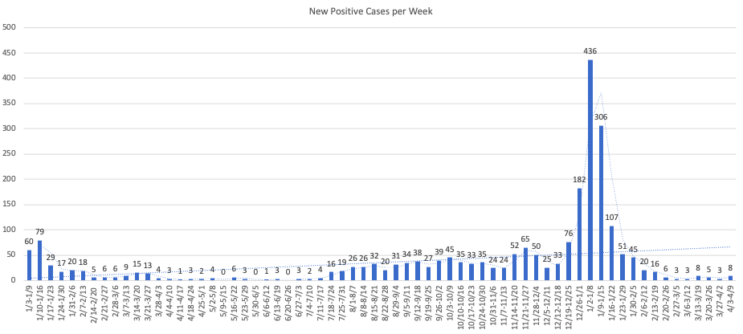

Slide 5
Number of POSITIVE cases by week for the past month
3/13 – 3/19: 8
3/20 – 3/26: 5
3/27 – 4/2: 3
4/3 – 4/9: 8

Slide 6
Hospital Status
No current COVID-19 related hospitalizations
Difficulty transferring patients
Status = Green

